Slide 1
Digital Communications with Arduino
Pierce Nichols 28 February 2015

Slide 2
Materials/software to have
One (or more) Arduinos
One class shield
Twenty male to male jumper wires
IR detector
100 ohm resistor
Twenty 470 ohm resistors
IR LED
NOR gate
Solderless breadboard
Two 8-LED blocks
Arduino IDE
Processing
SUMP (if you have two or more Arduinos)
Class Github repository

Slide 3
Motivation
Lots and lots of peripheral chips with digital interfaces.
ADCs
DACs
LEDs
Port Expanders
Sensors
Most use one of a few basic interfaces
SPI
I2C
Shift Register
Asynchronous Serial (UART)
Parallel

Slide 4
What we’ll cover today
Logic levels
Shift registers
SPI (Serial Peripheral Interface)
I²C (Inter-IC)
Asynchronous serial (Universal Asynchronous Receiver/Transmitter)
IR communication

Slide 5
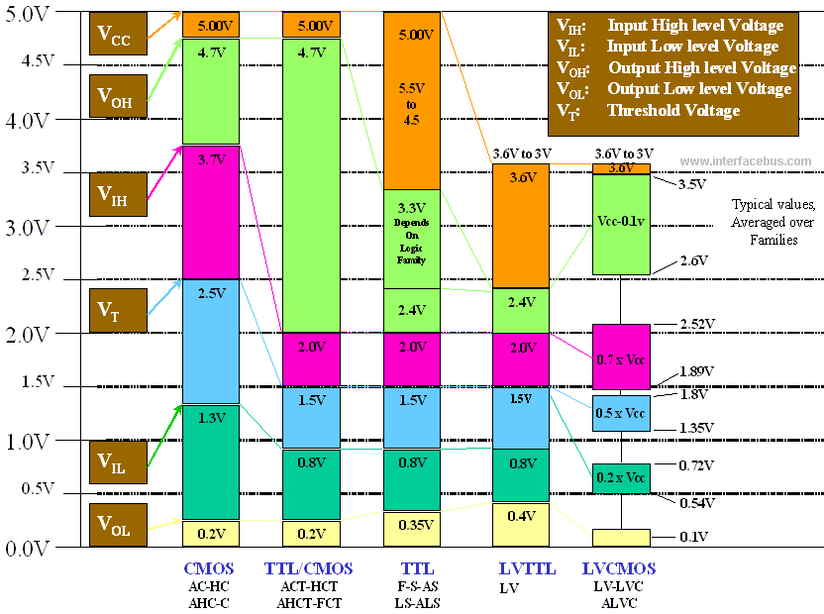
Logic levels

Slide 6
Some key terms…
Pull up: Short for ‘pull up resistor’. It is typically a resistor connected from an open pin to the power rail (VCC). Sometimes used as a verb, i.e. to pull up a line (to VCC), which may or may not involve a resistor.
Pull down: This is just like a pull up, except the pin or line is pulled to ground (0V).
Open drain/open collector: This is a logic output type consisting of a single N-channel MOSFET or NPN transistor (respectively) between the output and ground. It requires a pull up resistor to function correctly.

Slide 7
Some more key terms…
Serial: A form of communication that transmits a single bit per clock cycle. Almost everything we will be doing today uses serial.
Parallel: A form of communication that transmits multiple bits per clock cycle. Very fast, but requires lots of wire.
Active Low: A logic signal where the active state is low, or ground. Typically indicated on a schematic either by a circle in the line at an input or a bar over the signal name.
Most Significant Bit (MSB): The bit in a binary number with the highest value.

Slide 8
A note on discrete logic part numbers
There are two major series of discrete logic chips, called 74 series (TTL) and 4000 series (CMOS).
74 series part numbers are of the form 74<AAA><xxxx>, where the <AAA> tells you about the electrical characteristics of the logic (speed, levels, etc), and the <xxxx> tells you the complete function.
For example, the 74HC595 is an eight bit parallel out shift register (that’s the 595) in High-speed CMOS compatible (that’s the HC) TTL logic (that’s the 74).

Slide 9
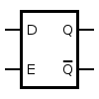
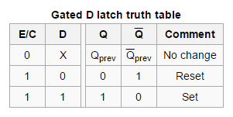
D-type latch
This is the building block of the shift register
When the enable (E) line is high, Q = D
When the enable line is low, Q holds the value of D when E went low.

Slide 10
Shift registers
A shift register is a chain of D latches
It loads data from the inputs and then moves (or shifts) it through its internal logic at the rate of one bit per clock cycle.
Real shift registers (like the 74HC595s on our shields) use an additional set of input or output latches to load data in from the inputs or write it out.
74HC595 is a serial-in/parallel-out device, so they’re output latches.
Parallel-in/serial-out shift registers like the 74HC597 have input latches instead.
Shift registers usually have both serial inputs and outputs, allowing them to be daisy-chained

Slide 11
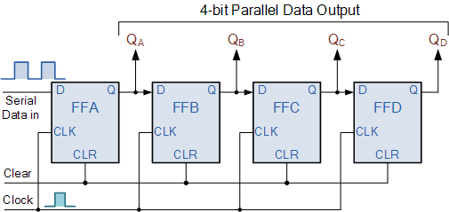

Slide 12
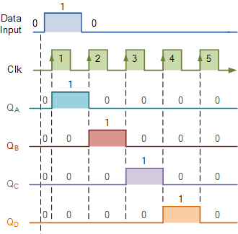

Slide 13
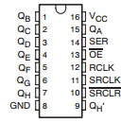
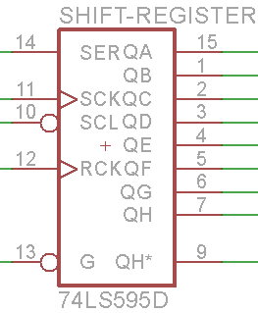
Shift register pins and symbols

Slide 14
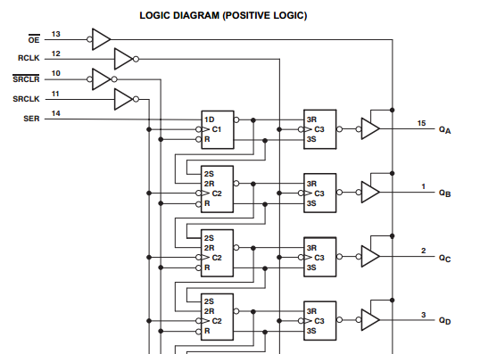

Slide 15
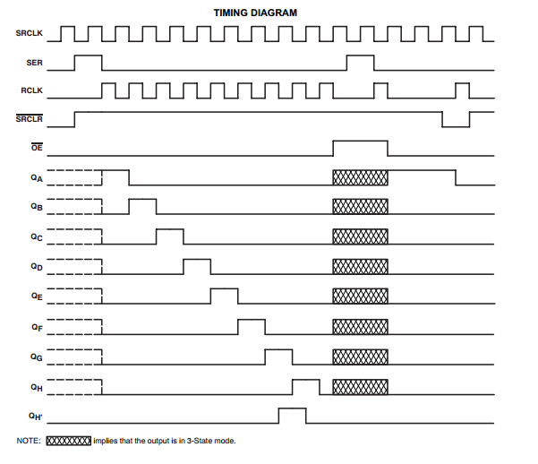

Slide 16
Class shield connections
Output Enable (OE) connected to ground (active)
Serial Input (SER) connected to D11
Serial Clock (SRCLK) connected to D13
Master Clear (SRCLR) connected to D7
Latch (RCLK) connected to D6
The eight shift register outputs are connected to the right-most LED block.
The serial output of the shift register is connected to the 5mm red LED.

Slide 17
Procedure for writing to a shift register
Set all inputs low
Set SER to the first bit of the data you want to write
Set SRCLK high, then low
Repeat steps 2 and 3 until all bits are shifted
Set RCLK high to switch shifted bits to the output
The Arduino environment provides shiftOut() to automate steps two to four in one byte chunks.

Slide 18
Shift register test script
The first test script is shiftRegTest.ino, which is designed to give you control over the shift register. Load it onto your Arduino and start serial monitor at 9600 baud.
The commands are as follows:
‘o’ shifts a 1 into the shift register
‘z’ shifts a 0 into the shift register
‘O’ shifts a 1 into the shift register and strobes RCLK
‘Z’ shifts a 0 into the shift register and strobes RCLK
‘r’ strobes RCLK
‘d’ followed by an integer between 0 and 255 shifts that number into the shift register using shiftOut, most significant bit first.
‘D’ does the same thing as ‘d’ and also strobes RCLK.
‘c’ strobes SRCLR

Slide 19
Example sequences to try
‘OZZZ’
‘OZZZZZZZZ’
‘ozzzzzzoor’
‘ozzzzzzzr’ followed by ‘c’ followed by ‘z’ and then ‘r’
‘D85’
‘D170’
‘D165’
‘D255’ followed by ‘zzr’

Slide 20
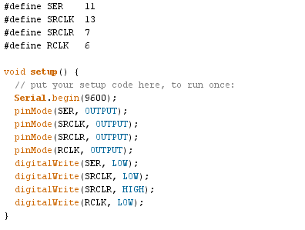

Slide 21
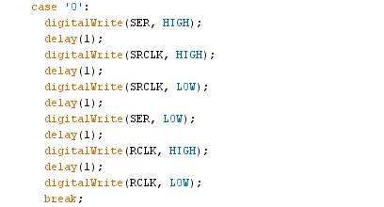

Slide 22
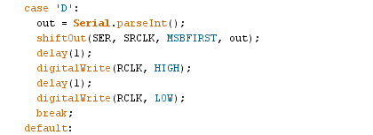

Slide 23
Fast shift register manipulation
A shift register write operation looks an awful lot like how SPI write works…
And since we are using the SPI hardware pins for the shift register, we can use the Arduino SPI library to write to the shift register a byte at a time.
Open shiftRegSPI.ino. Load and start serial monitor.
‘d’, ‘D’, ‘r’, and ‘c’ work as per the earlier example

Slide 24
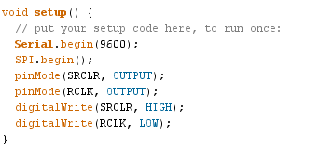

Slide 25
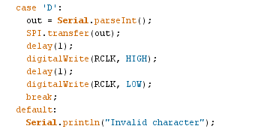

Slide 26
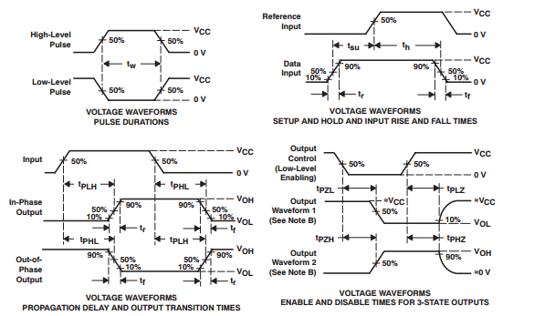
Shift register timing

Slide 27
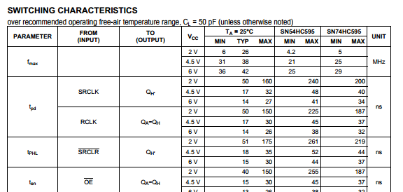
Shift register timing, continued

Slide 28
Example SPI peripherals
SD Cards
ADCs
DACs
Flash memories
Position sensors
Pressure transducers
Etc etc etc

Slide 29
SPI basics
Serial Peripheral Interface (SPI) is a synchronous serial communications bus.
The leader (also known as the master) provided a clock signal on a dedicated wire when the bus is active.
There is one wire for transmitting data from the leader to one or more followers (also known as slaves), typically labeled MOSI
There is one wire for transmitting data from the followers back to the leader, typically labeled MISO
The leader commands each follower in turn to pay attention by pulling a chip select (also known as slave select or SS) line low.
Each follower needs its own chip select line.
Possible to use shiftOut() and shiftIn() with any pins to do SPI, but it’s slow.

Slide 30
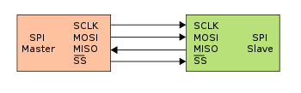
SPI wiring (single follower)

Slide 31
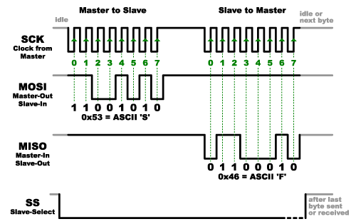
SPI interaction

Slide 32
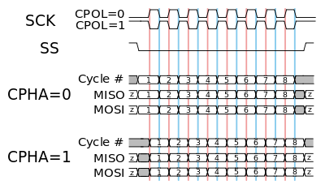
SPI timing diagram
Red vertical lines are clock phase = 0
Blue vertical lines are clock phase = 1

Slide 33
SPI EEPROM
Our demo for this is an SPI EEPROM (Electrically Erasable Programmable Read-Only Memory) with a capacity of 512 Kbits (64k bytes).
Atmel AT25512
Takes a 16 bit address
Will read or write up to 128 bytes in one operation
Also has various write protect features etc.
Broadly standard interface – hundreds or thousands of pin/protocol compatible parts

Slide 34
SPI EEPROM demo code
Load SPI_EEPROM_demo.ino
Load code & start serial monitor at 9600 baud
You can write a string of up to 31 bytes (default Arduino string buffer size plus terminating null) by the following process:
Enter W<address>, where <address> is the desired starting address (an integer between 0 and 65535).
You will receive a ‘>’ prompt. Enter any string into the serial monitor. It will be echoed as written to the EEPROM.
In order to read a string:
Enter R<address>
You will receive a ‘>’ prompt. Enter the number of bytes you’d like to read.

Slide 35
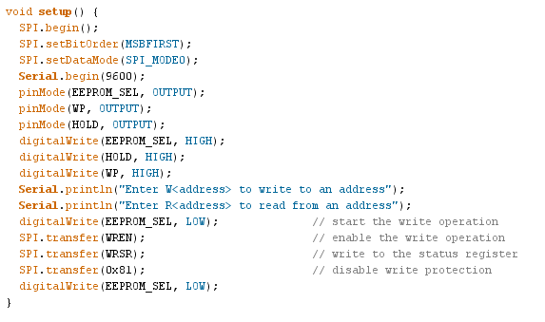
Setup code

Slide 36
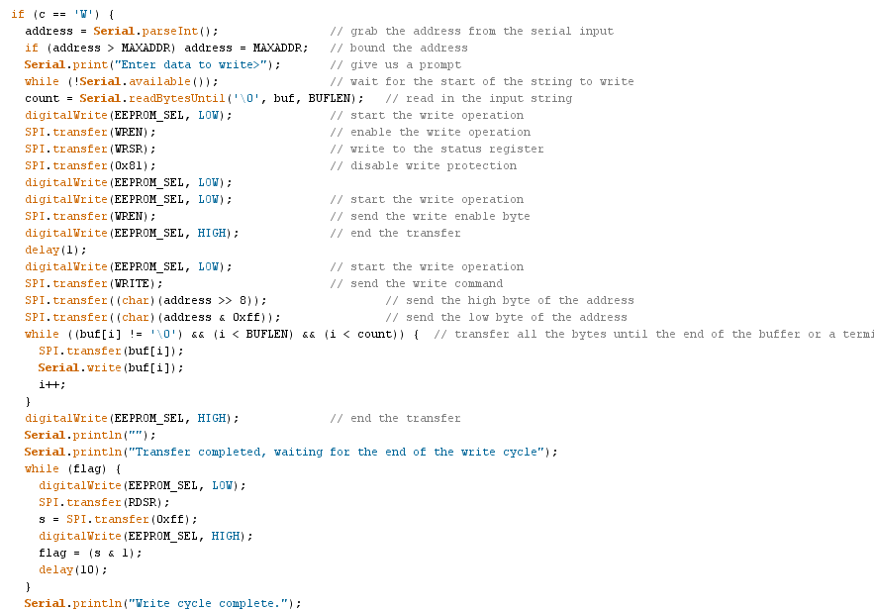
Writing code

Slide 37
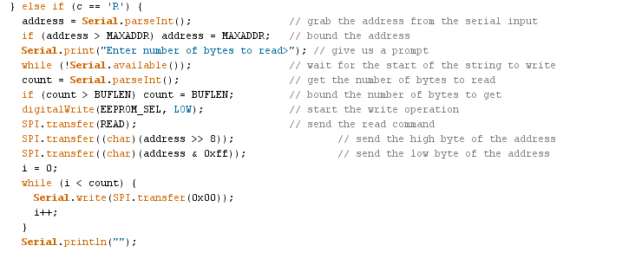
Reading code

Slide 38
One more level down…
In order to enable SPI, perform the following operations:
Set the MOSI, SCLK, and SS lines to outputs
Set the MISO line to input
Set the bits in the SPCR register to enable SPI and configure the speed, phase, and polarity as desired.
In order to write or read a byte out on SPI, do the following:
Set SS line low
Set SPDR equal to the byte you want to send (SPDR = dataByte;)
Wait for the SPIF bit of the SPSR register to be set.
Read incoming byte from SPDR

Slide 39
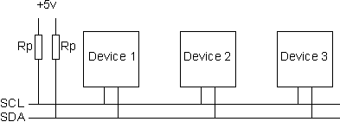
And now for something completely different I²C
I2C (Inter Integrated Circuit) is a two-wire serial bus developed by Phillips for connecting chips on a single PCB.
All devices on a bus share a single data line and a single clock line.
A common ground is also required.

Slide 40
I²C properties
The active state of each line is pulled low (active low)
Like SPI, I²C is a leader-follower protocol. The leader drives the clock line (SCL) and initiates all transfers.
Multiple leader busses are possible but unusual.
Each follower has a 7-bit address, with the 8th bit as a read/write flag
Newer chips may support 10-bit addressing
Due to trademark nonsense, the relevant Arduino library is called Wire.
On the Arduino Uno, A4 and A5 are SDA and SCL, respectively.

Slide 41
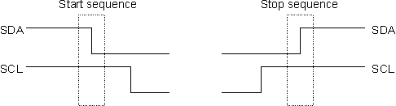
I²C start and stop sequences

Slide 42

I²C transmitting a byte
Each byte is transmitted most significant bit first.
Each byte is followed by an ACK, where the sender releases the SDA line and the recipient holds the SDA line low to acknowledge receipt.
Default clock speed for Arduino is 100 kHz

Slide 43

I²C address
The address byte is transmitted at the beginning of any transaction.
The top seven bits of the byte are the address of the device
The low bit is the read/write bit (1 for read)
So, for an address of 0x20 (our address), we transmit 0x40 to write and 0x41 to read.

Slide 44
MAX7313 Overview
I²C port expander
3.3V operation, 5v tolerant I/O
16 I/O channels, individually selectable
4-bit PWM for each channel
4-bit master PWM control
O16 can be used as either a 17th standard output or as an interrupt
Can blink output lines
Open drain outputs

Slide 45
MAX7313 communications
Each communication consists of the address, a command byte, and one or more data bytes.
The command byte is the address of the register you want to write to or read from.
When sending or requesting multiple bytes, the address auto-increments per Table 2 on pg 13 of the datasheet.
All chip functions are determined by values written to the registers (this is typical for microcontroller peripheral chips).

Slide 46
MAX7313 reading demo
Load max7313ReadDemo.ino and start serial monitor
Connect the eight shift register outputs to any combination of the MAX7313 pins
Type w<number> to write some of the shift register outputs
You should get ‘Interrupt fired’ followed by ‘Reading inputs’ and then a binary printout of the input states

Slide 47
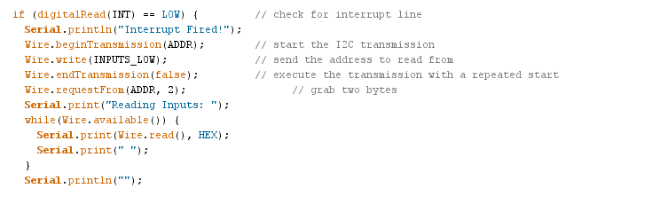
I²C reading code

Slide 48
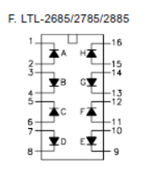
MAX7313 writing demo
Load max7313WriteDemo.ino and start serial monitor
Install the LED blocks in your solderless breadboard
Connect the cathode of each LED to an output channel of the MAX7313
Connect the anode of each LED to the 5V rail via a 470 ohm resistor.
Type w<value>, where <value> is any integer between 0 and 65535

Slide 49
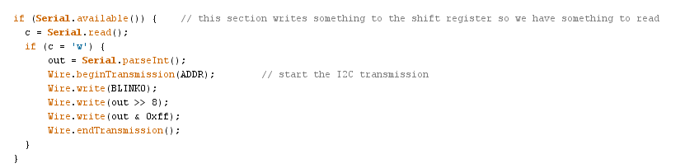
I²C writing code

Slide 50
UART (Universal Asynchronous Receiver Transmitter)
Often just referred to as ‘serial’
No clock signal – just a data input and a data output
Bit boundaries are determined by framing bits on each byte
Either point-to-point or one to many
Receive (RX) and transmit (TX) pins are typically labeled from the point of view of the device.
So we connect the transmit of one to the receive of another.

Slide 51
More UART properties
UART lines idle high
With appropriate external drivers, can use used to drive RS-232 or RS-485.
Standard Arduino framing is 1 start bit followed by 8 data bits, no parity bits, and one stop bit (abbreviated 8N1), so about 80% of the transmitted bits are available for data.

Slide 52
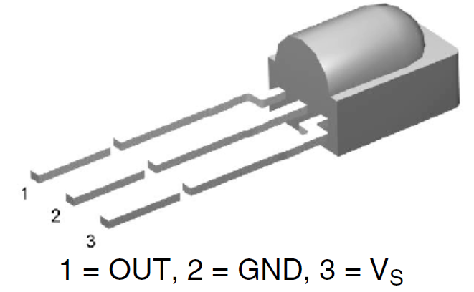
Serial communications via IR
It’s possible to communicate UART signals wirelessly using an IR LED and an IR receiver.
Our IR receiver (TSOP38238) receives only IR that is modulated at 38 kHz, which is typical for TV remote controls.
The output of the receiver is active low, i.e. low when a properly modulated signal is present.

Slide 53
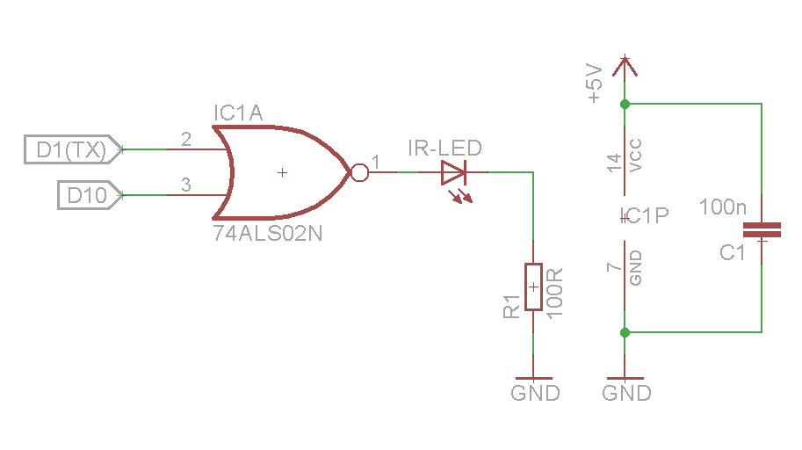
Serial IR communications hookup
Connect transmitter as shown.
Connect output of IR receiver to D0 (RX)
D10 is used as an output for the Tone library.
The NOR output is high only when both inputs are low… which produces a matching signal to D1 on the IR receiver output.

Slide 54
Serial IR demo code
Load serialIRtransmitter.ino on one Arduino and serialIRreceiver.ino on another. Start serial monitor on the receiver side at 2400 baud
Point the LED at the receiver. Note that the beamwidth is very narrow, so this may take a few tries.
Watch the serial monitor for signs of contact.
Try moving the two sides apart.

Slide 55
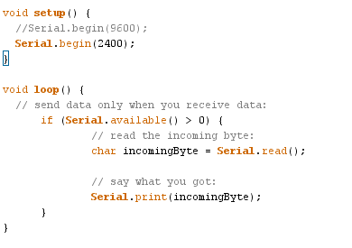
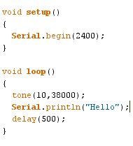
Serial IR code

